Slide 1


Slide 2
Overcoming Obstacles Allowing the Obstacle to become the Way
With Jordan Hitchens

Slide 3
My Stats
14 Year Old Eagle Scout
15 Year Old Vigil Member
Never a lodge chief
Section Vice Chief @ 17
Section Chief @ 18
National Vice Chief @18
34 Years Old, 1981
Married to Megan Hitchens
10 month old son: Henson
Work in the Operating Room
I’d like to be your friend

Slide 4
Objectives
Understanding Perception
Preparing for Action
Understanding your Will

Slide 5
Part 1: Perception
Perception is how we see and understand what occurs to us and what we decide those events will mean. Our perceptions can be a source of strength or of great weakness.
Which type of shoe salesman are you?

Slide 6
Remain Objective
“Blank” happened and it was terrible.
Two impressions were made: “blank” happened – objective, it was terrible—subjective.
Learn how to separate yourself from the situation.
Pretend it is not happening to you. It allows you to size up your scenario much more quickly and dispassionately.
We know the right answer most of the time, the trick is we do not know the right answer for ourselves because we loose our objectivity.

Slide 7
Control your Emotions
When you face an obstacle, ask yourself this one question: “Does what happened keep me from acting with justice, generosity, self-control, sanity, prudence, honesty, humility, or straightforwardness?
If, “no”, then get back to work. There is no need to freak out.

Slide 8
Find the Opportunity
Adopt a growth mindset vs. fixed mindset
Fixed mindset assumes our character, intelligence and creative ability are static given and cannot be changed in any meaningful way.
Growth mindset thrives on challenges and see failure not as evidence of unintelligence but as a springboard for growth and stretching our abilities.

Slide 9
Focus on what can be controlled
Emotions
Judgments
Creativity
Attitude
Perspective
Desires
Decisions
Determination
Weather
Economy
Circumstances
Trends
Disasters
Other people

Slide 10

The ones who see things differently…
“To be yourself in a world that is constantly trying to make you something else is the greatest accomplishment.” Ralph Waldo Emerson

Slide 11
Change your questions to find the good in all things…
Don’t wish that it was easier, wish that you were better.
Don’t wish for less problems, wish for more skills.
It’s not about lacking resources, its about lacking resourcefulness.
Find the good in this story…

Slide 12
Part 2: Action
We can always greet our obstacles with:
Energy
Persistence
Resilience
Strategy
Craftiness
Eye toward opportunity
Avoid greeting obstacles with:
Procrastination
Excuses
Negative thinking
Preconceived notions of what is and is not possible

Slide 13
Get Moving
“We must all either wear out or rust out, every one of us. My choice is to wear out.” –Theodore Roosevelt
You are a perfect reflection of your past choices.
Action often creates opportunity.
There is never a point in your life where it is the right time to do a great things.

Slide 14
Anticipate
I can make one guarantee, it is that things will go wrong. The only way we can deal with this reality is anticipate it or prepare for it.
If things going wrong comes as a surprise to you, you will be miserable.

Slide 15
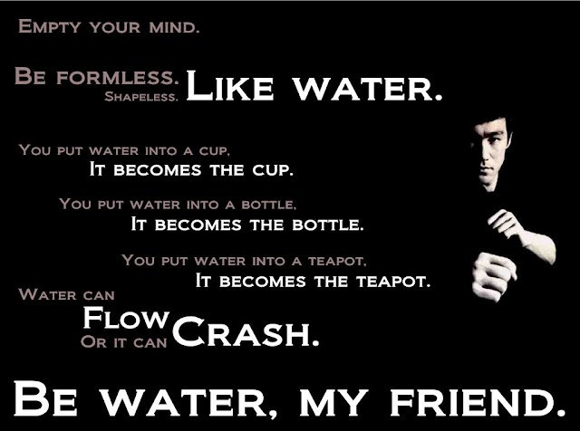
The Art of Acquiescence
Traffic signals: Red, Yellow, Green. Don’t take them personally.
Over a long enough time horizon most obstacles are just blips—they are a pebble in the stream of life.

Slide 16
Love What Happens
Love whatever happens to you. Face challenges with unfailing cheerfulness.
Love is the act of turning what we must do, into something that we get to do.

Slide 17
Perseverance
Perseverance vs. Persistence
Action vs will
One is energy the other is endurance
Somehow, someway, someday, nothing will stop you.

Slide 18
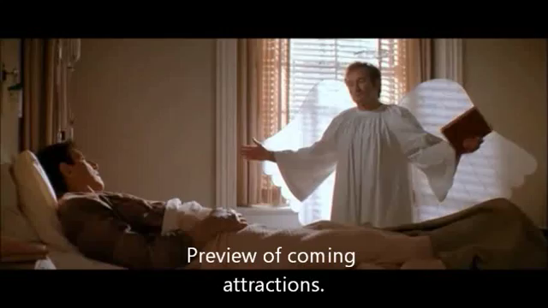
Meditate on your Morality
Let the clock invigorate your action.

Slide 19
Conclusion
Once conquered, prepare to start again.
Passing one obstacles simply says you are worthy of more obstacles (Star, Life, Eagle).
Each time you will develop strength, wisdom, and perspective.
Seek new peaks, both in the outside world and in your inner world.

Slide 20
Communicating vision

Slide 21
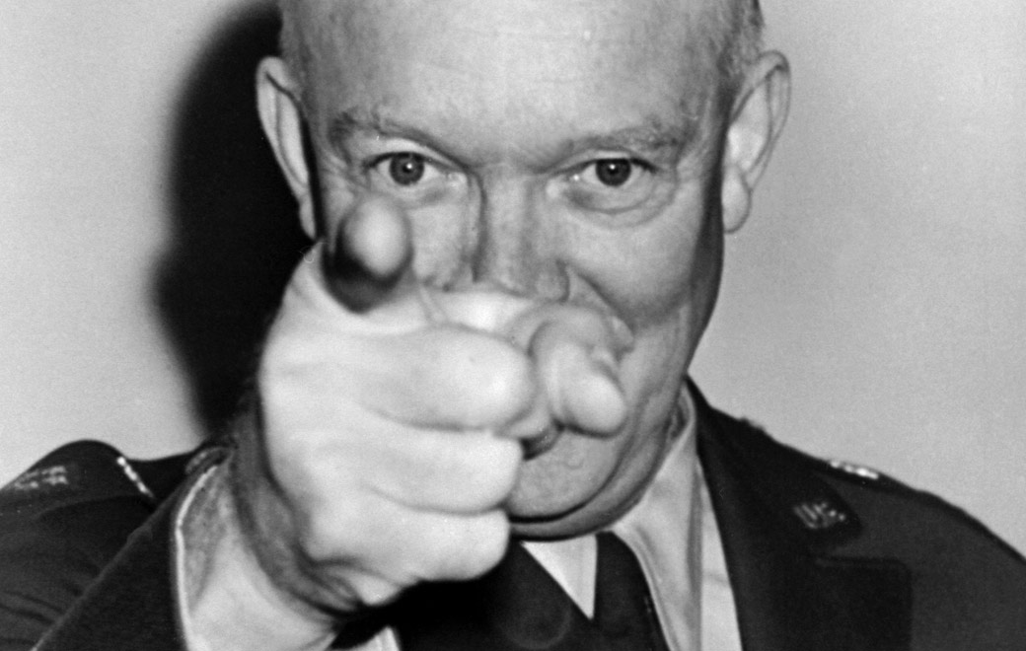
Finding your vision
“Leadership is the art of getting someone else to do something you want done because he wants to do it.”
Dwight D. Eisenhower

Slide 22
What does your vision look like?
Show us your pictures!
Take out the picture you drew last night
Tells us about your vision
What are you trying to communicate?
Why this vision?
How would you communicate this to others?

Slide 23
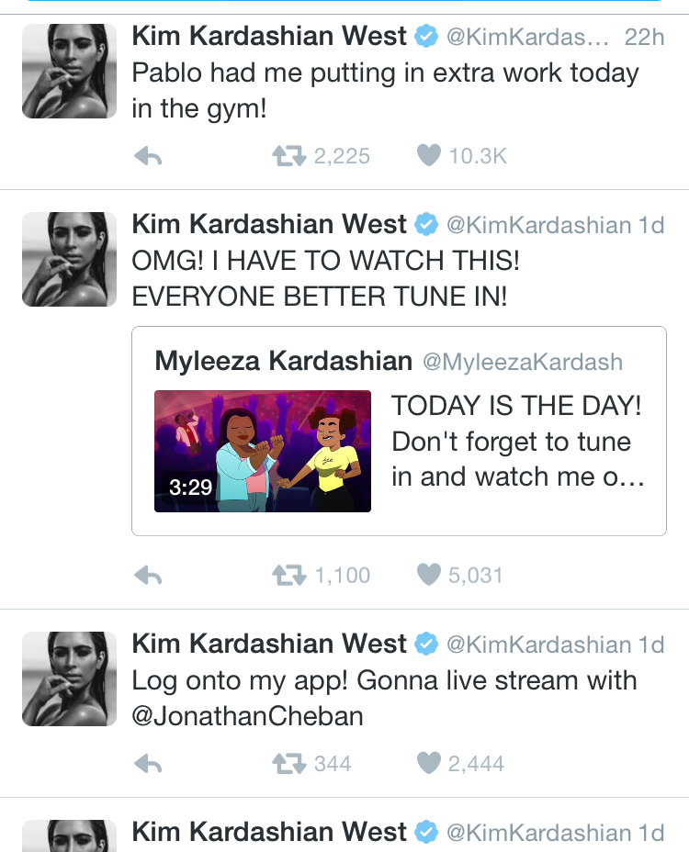
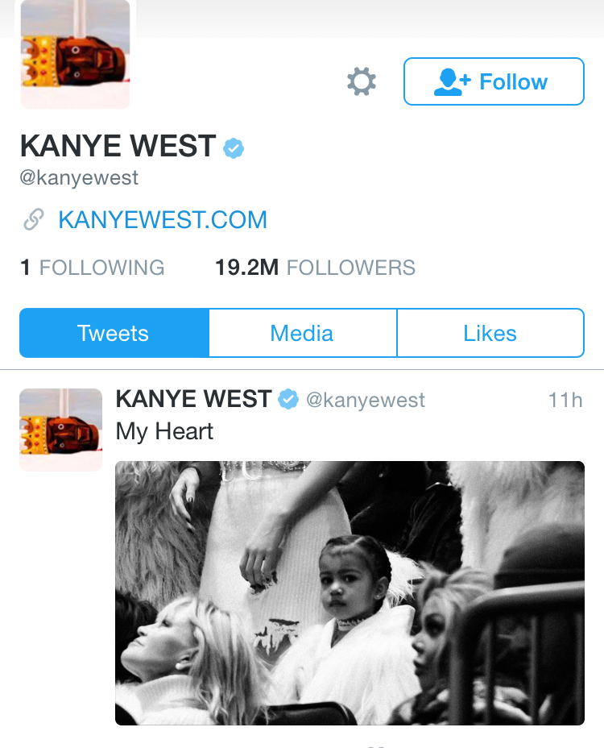
Implementing the Vision

Slide 24
Good luck!
“The art of communication is the language of leadership.”
James Humes, Presidential speechwriter

Slide 25
Creating accountability

Slide 26
Discussion Topic:
When was a time you let someone down?
What could you have done differently?
What lessons did you learn?
How did you address it?

Slide 27
“Your greatest source of power is your ability to change how people feel.
Jeff Grimshaw & Gregg Baron, Leadership Without Excuses

Slide 28
Creating a culture of accountability
Clearly communicate expectations
Promote ownership
Provide constructive feedback
Follow up!!!

Slide 29
Role play exercise
Scenario: You’re the Chief Elangomat for your lodge’s Ordeal and you’re meeting with a first-time elangomat to go over his role for the weekend.

Slide 30
Inspirational Leadership
Burn Your Boat, Push on Failure, How are you following the rules?

Slide 31
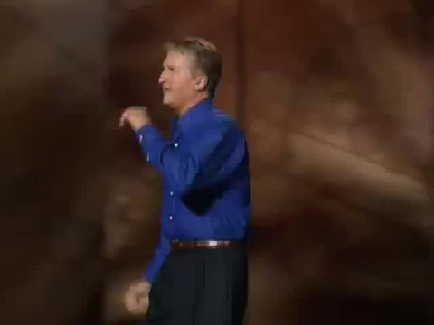
Burn the Boats!

Slide 32
The Pendulum of Life
Failure
Rejection
Defeat
Pain
Sadness
Success
Acceptance
Happiness
Victory
Joy
Your Comfort Zone

Slide 33

Take This Test
Rules
Lines must be straight
When drawing the lines, the pen/marker cannot be lifted off the table and must go through 9 dots.
1 minute to work alone
30 seconds to work as a group

Slide 34



Some of the answers…

Slide 35
What matters in the classroom?
Knowing the right answer?
Knowing the right question to ask?

Slide 36

If knowing the answer was the real value, we would all be billionaires
5 Exobytes = 5 Billion Gigabytes
From the start of time → 2003
In 2010 ~ 2 Days
In 2013 ~ 10 Minutes

Slide 37
Exercise
Identify a boat…burn it.
Identify a fear…confront it.
Define a question no one is asking... ask it.
Tell two strangers your dreams/goals. Tell them what you are afraid of. Ask them to share with you.

Slide 38
How to Inspire?
LEADERS
Let people know you care. Be vulnerable.
Describe what success looks like.
Prepare to get comfortable in uncomfortable scenarios.
Ask the right questions…
LEADERS IN TRAINING
Find out what other people care about.
Ask others what success looks like to them.
Tell them this will be hard but it will be worth it.
Ask them to think about why we do the things we do and do they make any sense?

Slide 39
A Thing of the Spirit
How to keep things fun while leading your group and accomplishing your goals

Slide 40

Define fun?

Slide 41

What does fun look like while being a leader?

Slide 42




Know who you are working with.

Slide 43

Treat Your Team Like Gold

Slide 44

Celebrate accomplishments of goals

Slide 45

Be the Calm and Steady Leader

Slide 46

Having fun while overcoming obstacles

Slide 47

Get Personal

Slide 48
To Summarize
You can have fun as a leader
Know who you are working with- what do they find fun
Treat your team like gold- It’s the little things
Celebrate together your Goals- Parrrrtttyyyy
Be the Calm and Steady leader
Make obstacles into games- find the fun in overcoming them
Get personal

Slide 49

Go have fun!

